Slide 1

IBM Project Presentation
on
Movie Review Sentiment Analysis - using Modern Architecture
By
Group ID – 31
Team Members name & Enrolment No
Patel Maharshi (23162172007)
Nitish Marker (23162582009)
Bhavin patel(23162582002)
Under the guidance of
Dr Sheetal pandya / Mr Palwinder Singh
Institute of computer technology
Date - 21-2-2026

Slide 2
Problem Statement
Traditional movie review platforms rely on manual ratings.
Lack of intelligent sentiment-based rating systems.
Need for AI-driven automated review analysis.

Slide 3
Introduction
Full-stack AI-powered movie review web application.
Users can register, login, browse movies and write reviews.
AI generates rating (1–10) based on sentiment analysis.

Slide 4
Project Objectives
Integrate Machine Learning with Web Development.
Implement secure authentication system.
Store relational structured data.
Provide personalized dashboard experience.

Slide 5
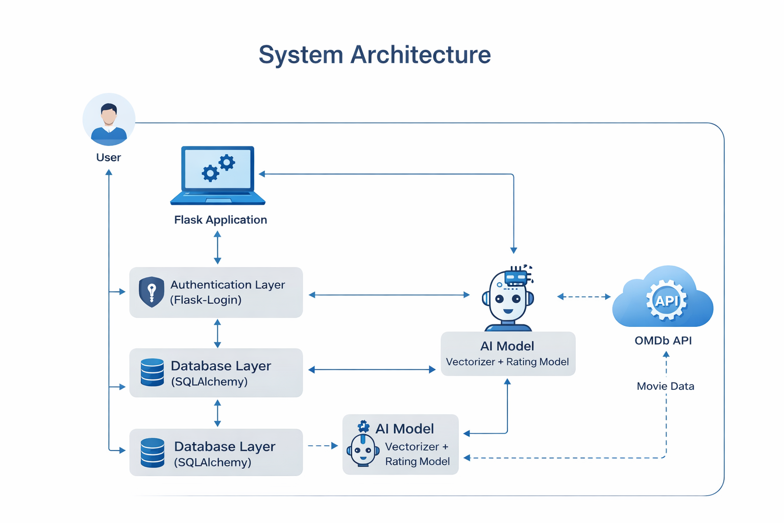
System Architecture
User → Flask Application → Authentication Layer
Database Layer (SQLAlchemy ORM)
AI Model (Vectorizer + Rating Model)
OMDb API Integration

Slide 6
Technology Stack
Backend: Python 3.12, Flask
Database: SQLite, SQLAlchemy
Authentication: Flask-Login
Machine Learning: Scikit-learn
Frontend: HTML, CSS, Jinja2
API: OMDb API

Slide 7
Process Model
Incremental Development Model
Phase-wise implementation and testing
Authentication → Database → AI → Dashboard → UI Enhancement

Slide 8
Database Design
User Table (id, username, email, password_hash)
Movie Table (id, imdb_id, title, poster)
Review Table (review_text, ai_rating, user_id, movie_id)
Relational Mapping between User, Movie and Review

Slide 9
Authentication System
Implemented using Flask-Login
Password hashing for security
Session management
Protected routes: /dashboard, /home

Slide 10
AI Sentiment Model
Model loaded using Joblib (rating_model.pkl)
Text vectorized using trained vectorizer
Predicts score between 1–10
Sentiment classification: Positive / Neutral / Negative

Slide 11
Review Aggregation
Average rating calculation
Star equivalent (out of 5)
Sentiment summary generation
Total review count per movie

Slide 12
Dashboard Features
Personalized review history
Displays rating, sentiment and timestamp
Fully linked to logged-in user
Dynamic star visualization

Slide 13
Conclusion
Successfully integrates ML with Web Architecture.
Demonstrates full-stack AI implementation.
Scalable foundation for future enhancements.

Slide 14
Thank You

